Slide 1
Modern AI
Course Logistics and Introduction

Slide 2









About Me
Pre-2010
2010-2013
2013-2021
2021-Today

Slide 3

Today’s Agenda
1. COURSE LOGISTICS
Website, schedule, grading and evaluation criteria.
Course textbook, lecture format, etc.
2. INTERESTING USE CASES
Frivolous, academic, and practically useful.
A recent failure, and societal concerns.
3. QUICK INTRODUCTION
What is a neural network?
How does it work?

Slide 4


What’s In the News?

Slide 5
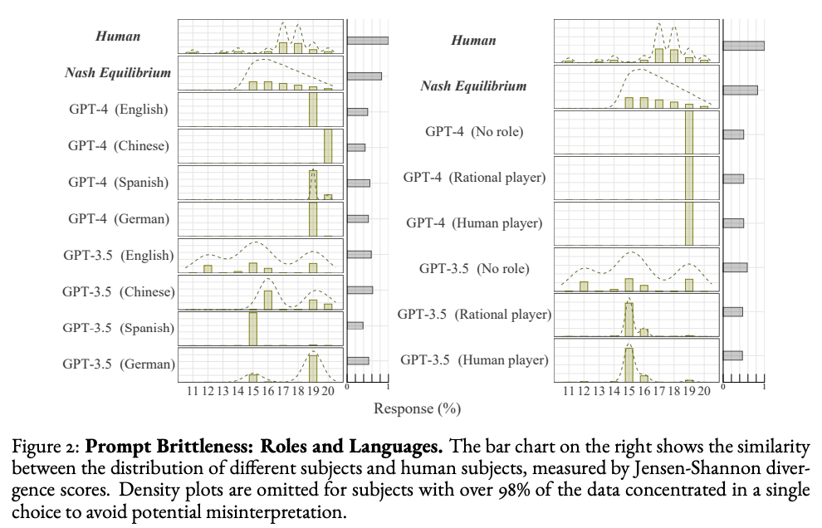
Some Research

Slide 6
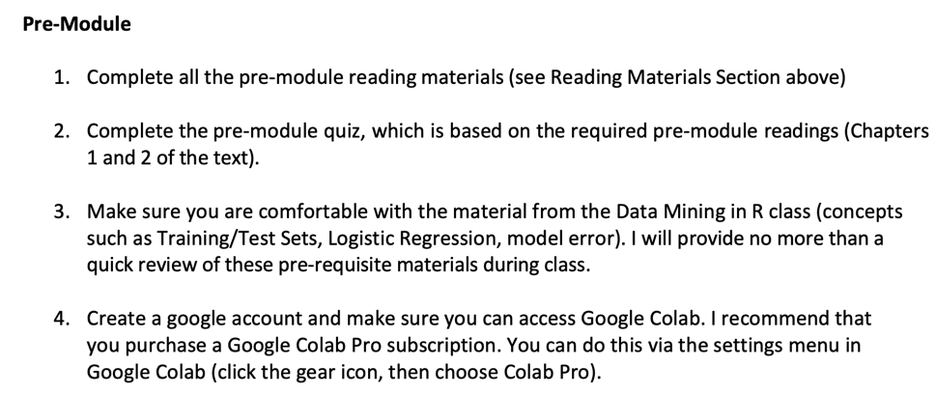
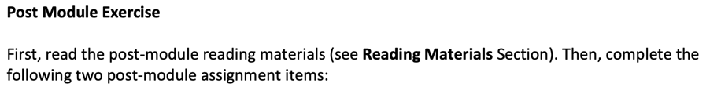
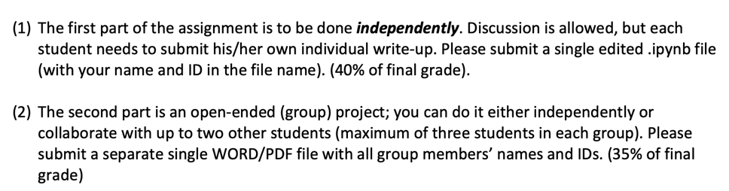
Grading & Evaluation
25%
40%
35%

Slide 7

Course Textbook
Chollet, François. (2025). Deep Learning with Python (3rd Edition). Manning Publications Co. ISBN-13: 978-1633436589. https://deeplearningwithpython.io

Slide 8
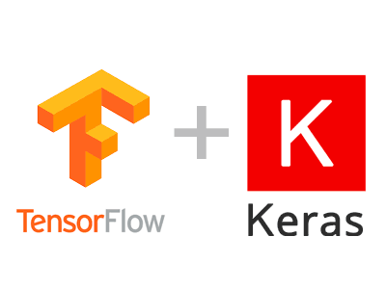


Required Software
You can access Google Colab at https://colab.research.google.com. You will want to use your NYU Google account credentials!

Slide 9
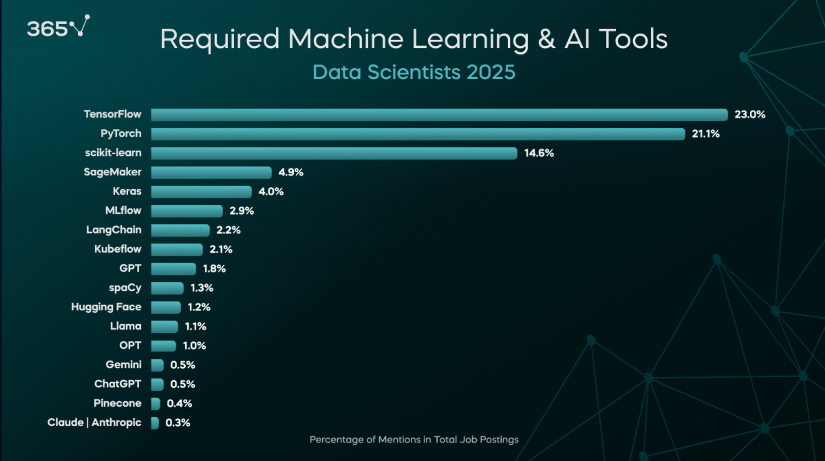
Why Keras?

Slide 10
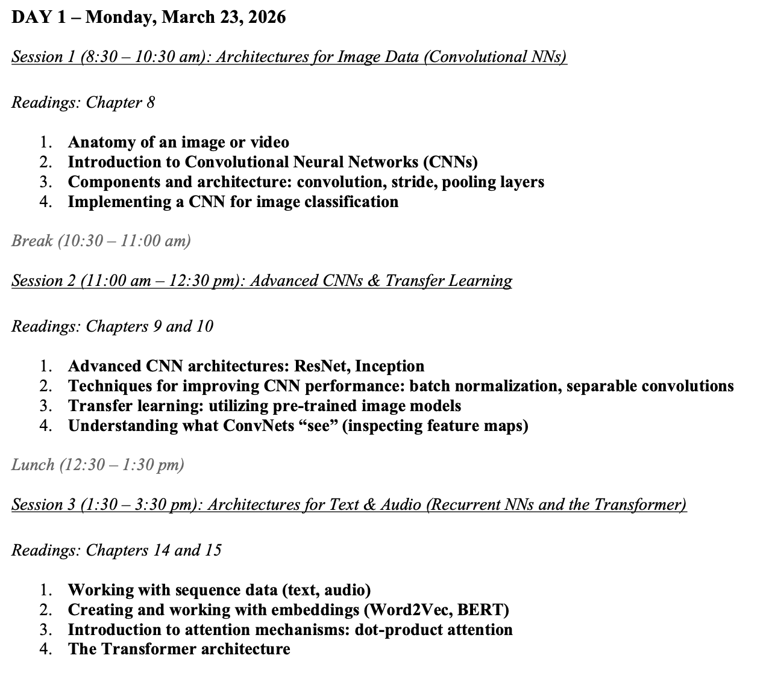
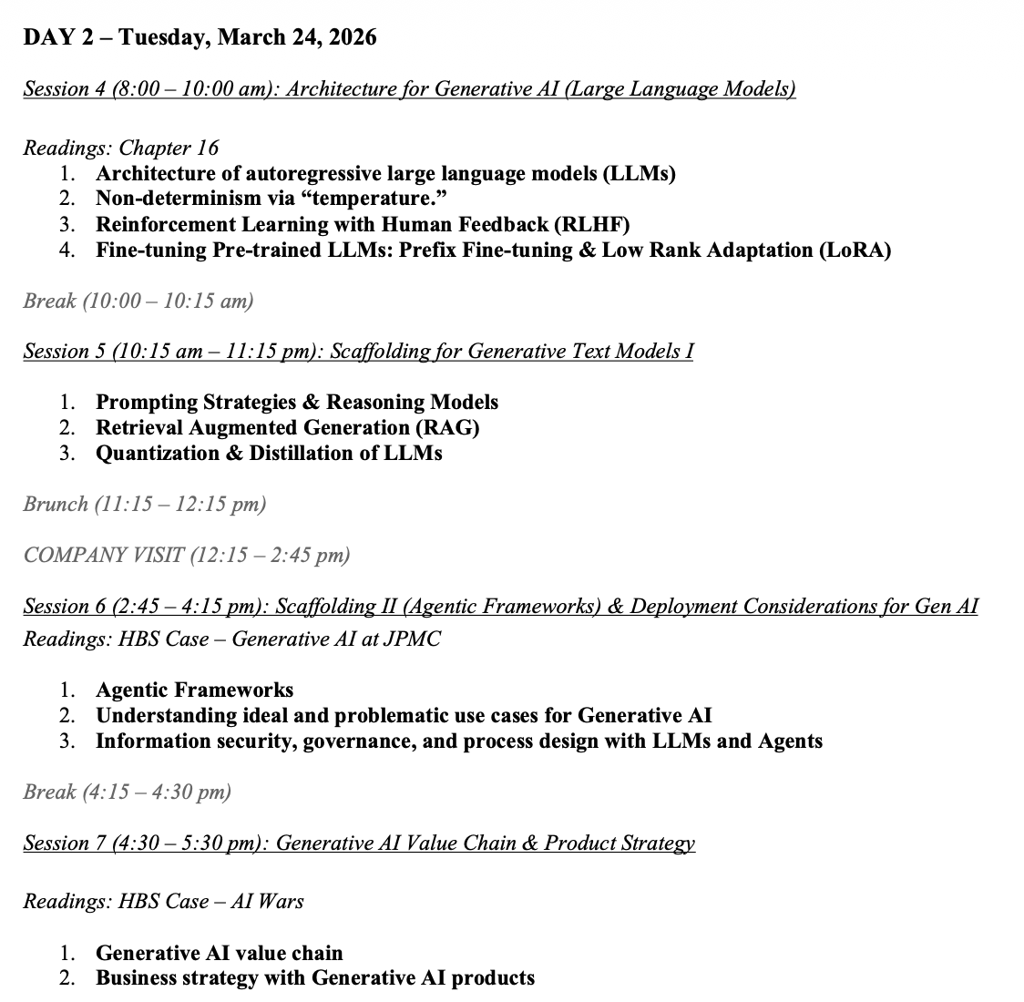
Course Timeline

Slide 11

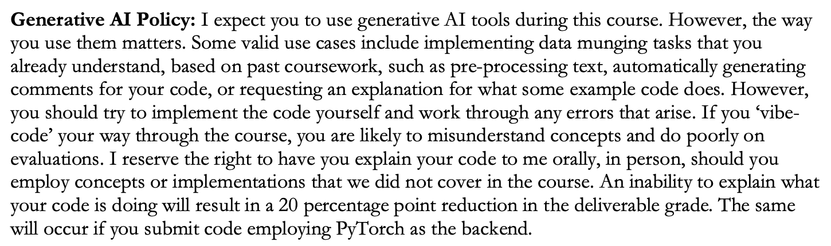
Policy

Slide 12
Any Questions?

Slide 13

Pre-Quiz
Notes:
Your familiarity with tools / your interests.

Slide 14
What is ‘Deep’ (vs. Shallow) Learning?

Slide 15
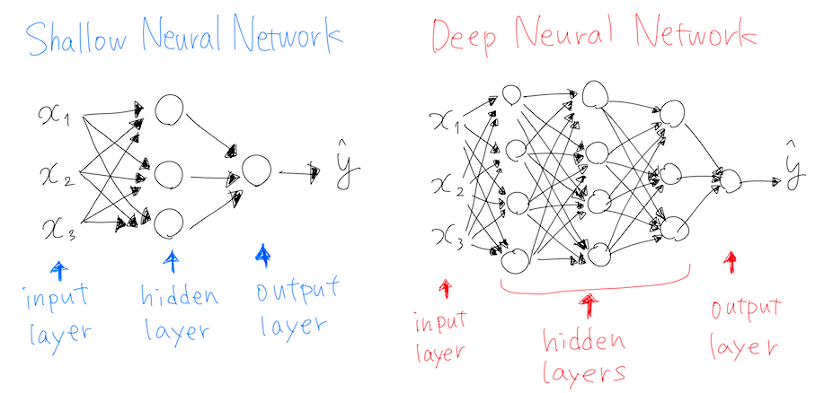
What is ‘Deep’ Learning?
Notes:
Most other ML approaches are shallow (they map inputs to outputs in a single layer / transformation, or few layers). Deep here refers to the fact that there is a layered approach to transformation. 4 or more layers, generally, by which transformations feed into other transformations, enabling flexible representation of mappings.

Slide 16
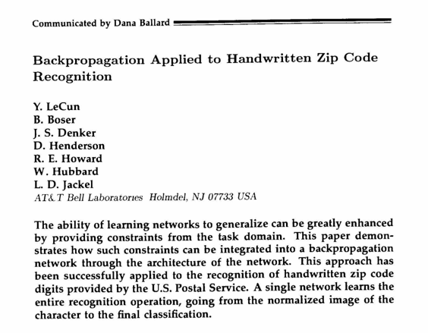
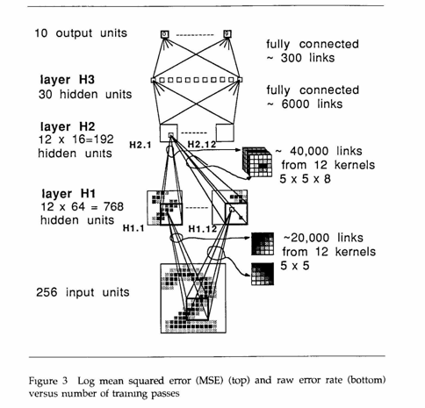
Where Deep Learning Started

Slide 17

Modern Examples: Identity Verification
Notes:
Note that I don’t expect you to implement a neural network from scratch. This is just to give you an understanding of how they work.

Slide 18


Modern Examples: Fraud Detection
Notes:
https://www.neuro-id.com/wp-content/uploads/2024/08/NEURO_ONBOARDING.mp4

Slide 19

Modern Examples: Fake Review Detection
Notes:
https://www.neuro-id.com/wp-content/uploads/2024/08/NEURO_ONBOARDING.mp4

Slide 20


Modern Examples: Gunfire Detection

Slide 21

Modern Examples: Part Failure Prediction

Slide 22

Modern Examples: Audio Transcription

Slide 23

Audio Translation

Slide 24
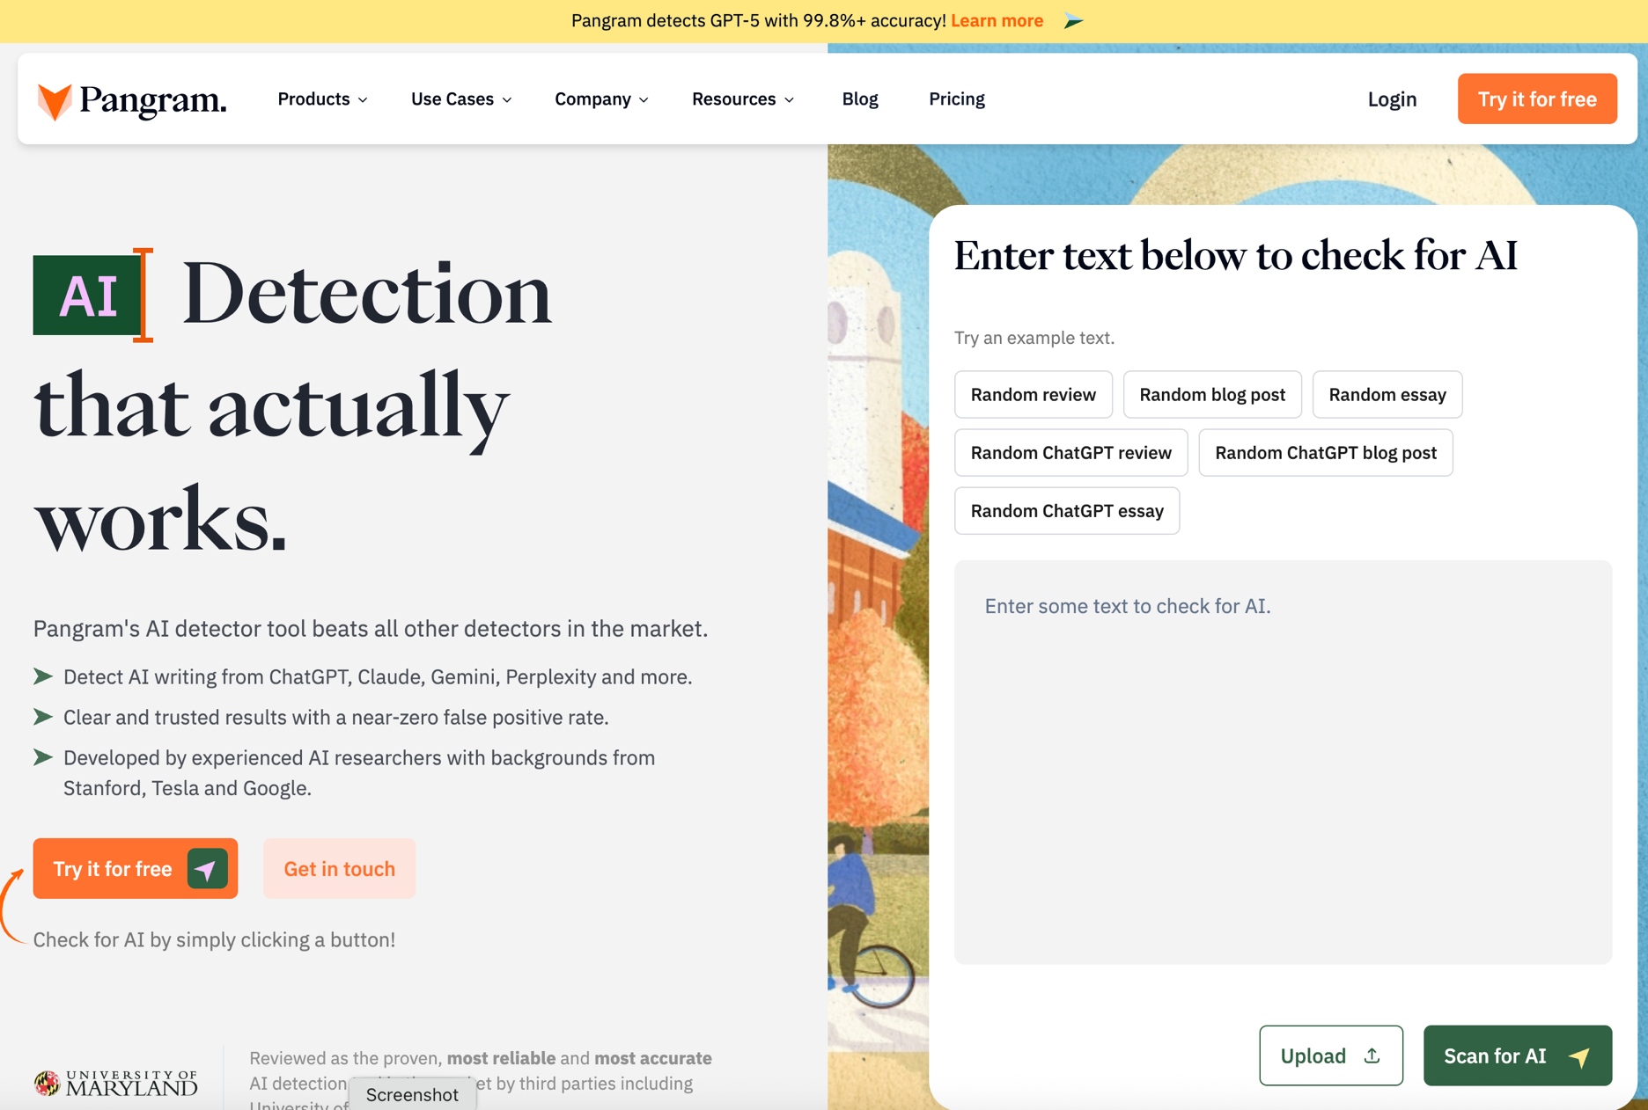
Modern Examples: AI Text Detector

Slide 25

And of course…

Slide 26



These Technologies Bring New Problems

Slide 27
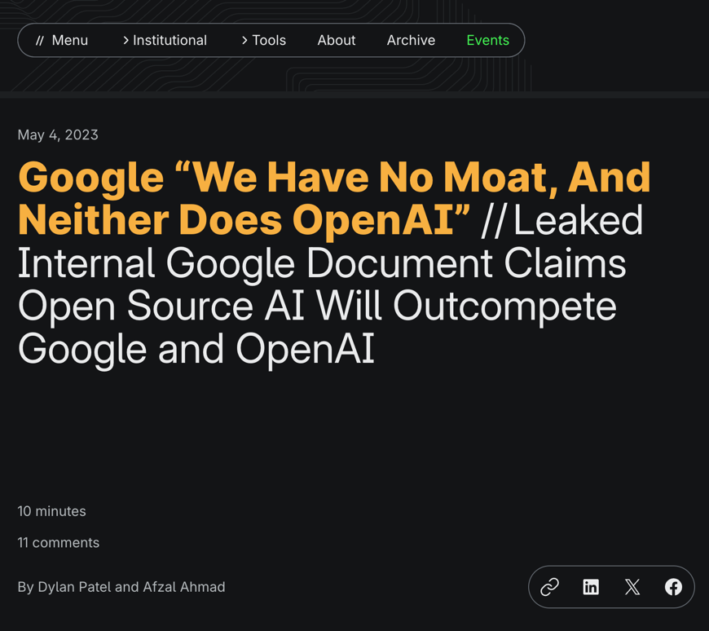
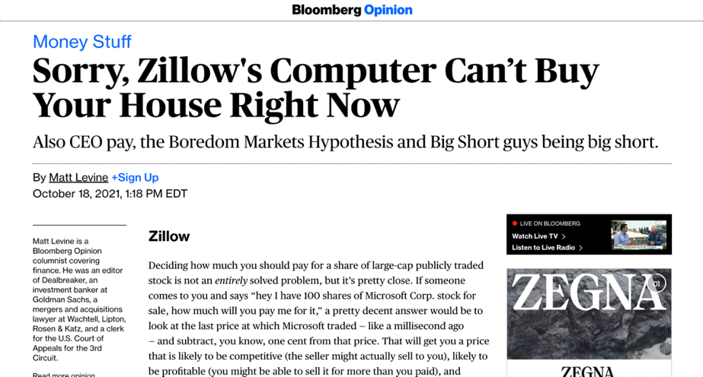
Business Process / Model Still Matters

Slide 28
How It Works, Conceptually

Slide 29
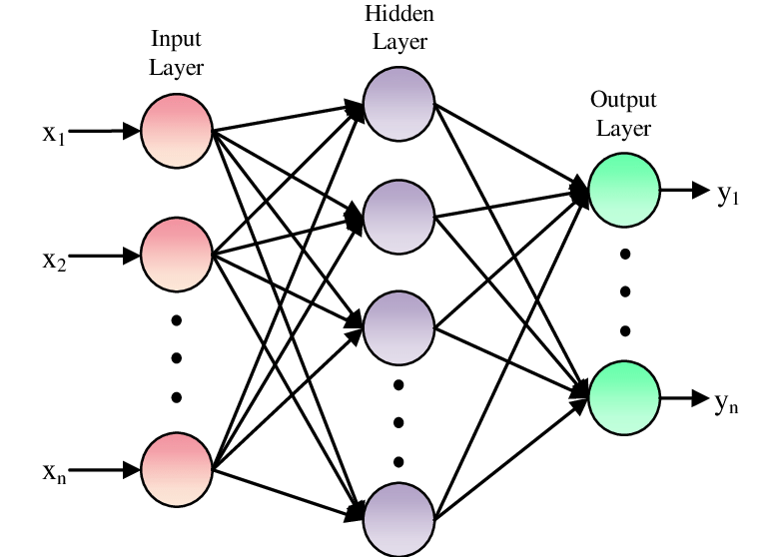
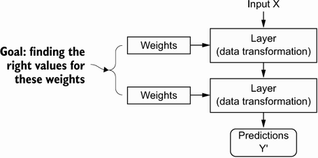
Model Parameters

Slide 30
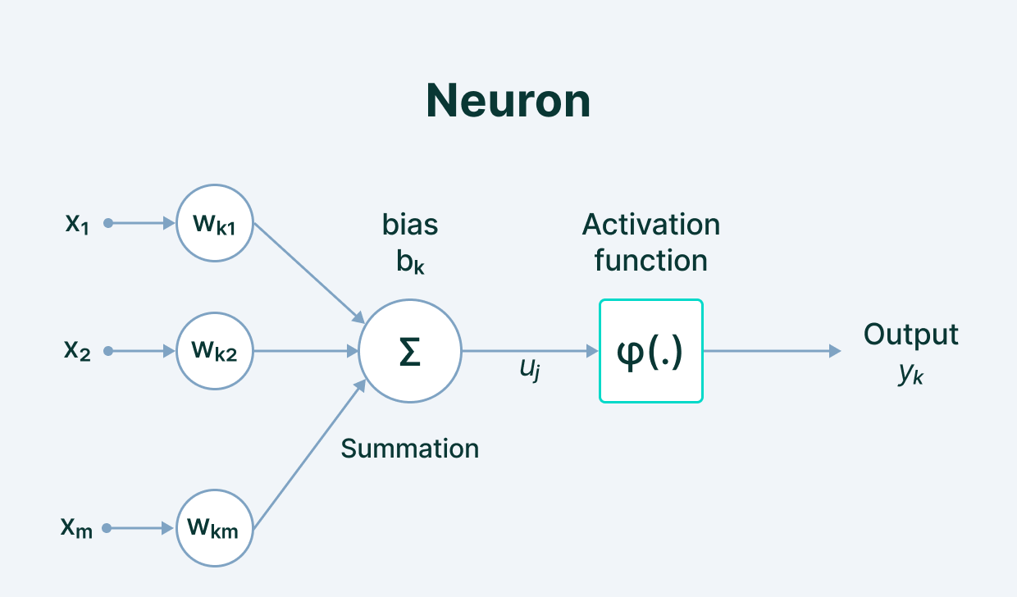
Model Parameters
Notes:
We define the network structure (layers / nodes / edges) and the activate functions (within each node). Our data, X and Y (inputs and labels) are given. Our goal is then to “learn” the remaining parameters, i.e., the w’s and b’s.

Slide 31
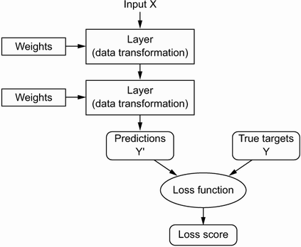
Loss Function (Error)
Notes:
How do we learn the parameters? We need a way to quantify how well we are doing. This is what the loss function is for; it informs our optimization about how ”optimal” our current set of parameter values is.

Slide 32
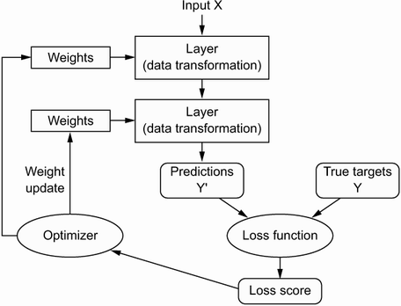
Optimization
Notes:
How do we implement the learning (optimization)? Gradient descent. We identify where we are on the loss curve, figure out a first derivative along all available dimensions (i.e., along all parameters), and proceed where the gradient is most negative (i.e., where the loss function progresses most rapidly toward zero. For this to work, we need to be able to figure out the gradient along each dimension (for each parameter) in a computationally efficient way (remember, some of the biggest models have thousands or millions of parameters!).

Slide 33
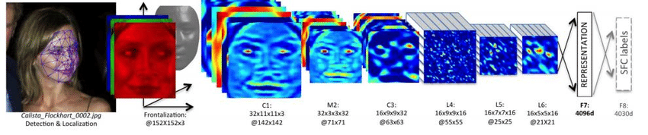
When to Learn Deeply (vs. Not)
COMPLEX RELATIONSHIPS
Complex, non-linear, interactive relationships and mappings; common use cases involve unstructured (high dimensional) data. Deep learning techniques remove the need for feature engineering, a daunting task.

Slide 34
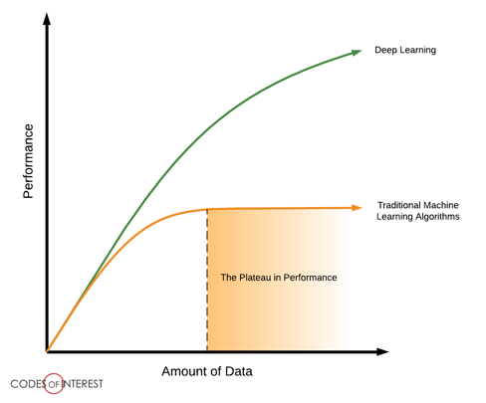
When to Learn Deeply (vs. Not)
LOTS OF DATA ON HAND
To be able to learn those complex mappings, typically requires many, many, many training examples.

Slide 35
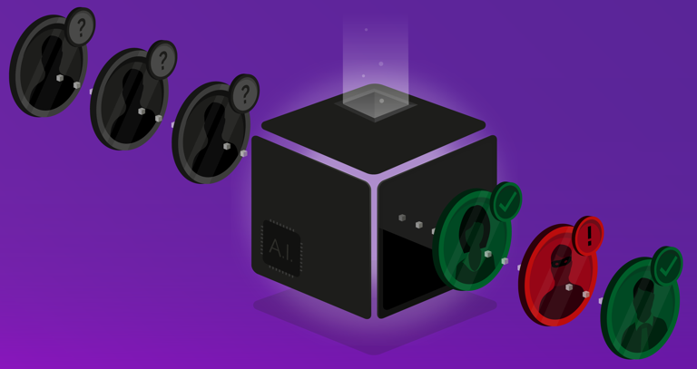
When to Learn Deeply (vs. Not)
LITTLE NEED FOR UNDERSTANDING
Although there have been advancements in explainable and interpretable AI, deep nets are notoriously “black box” algorithms.

Slide 36
Why Did Deep Learning Take Off?

Slide 37

Video Games
Notes:
GPUs were developed to handle parallel processing capabilities needed for high end video game graphics. Turns out those same designs were useful for training a neural net (parallel computation, through vectorization of code). Basically, training a deep net involves performing a shitload of matrix multiplications. It’s better if we can do those calculations in parallel rather than sequentially. GPUs (and now TPUs) enable a ton of parallelization, speeding up the calculations.

Slide 38
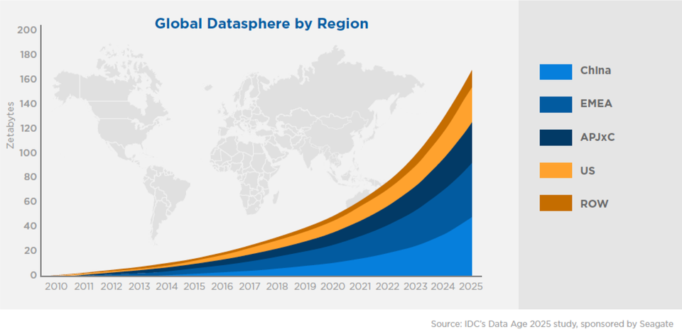
Data

Slide 39
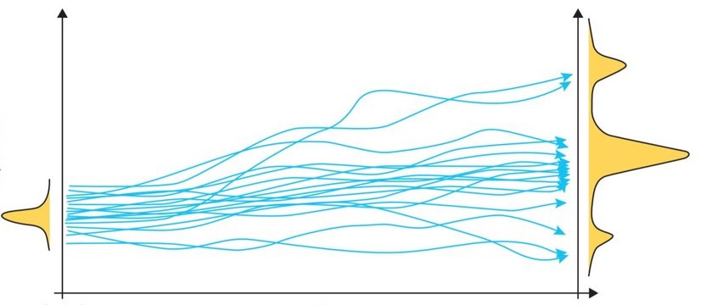
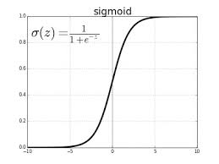
Algorithmic Improvements

Slide 40
See You Next Time!

